Slide 1

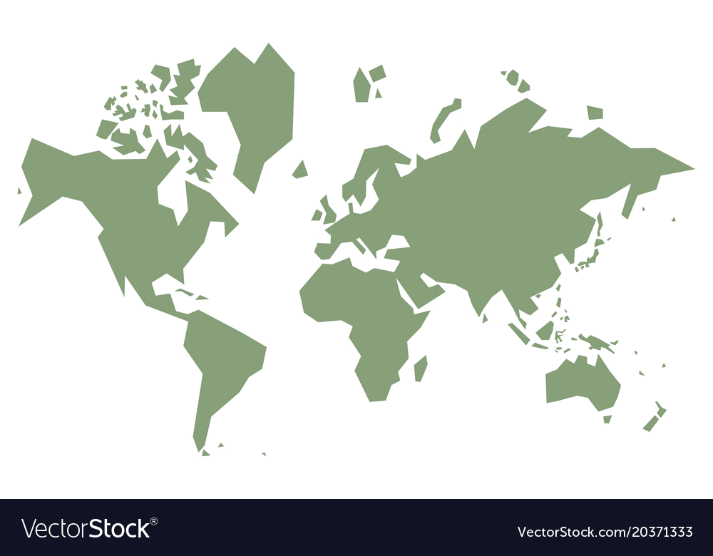
Viking Explorer
Click on the blue circles to travel to that part of the world and see what you will find there. Then you must decide whether you want to Raid them or Trade with them.
Click on ‘Back to the Map’ to return home

Slide 2
You have visited Britain.
Britain has lots of different materials, foods and goods. It is good for farming.
From here you can collect:
Basic fruits and vegetables – apples, pears, cabbage
Meat – pork, chicken, beef, duck
Fish
Mead and beer
Special items:
Tin – good for making things you can sell
Honey – good for adding to food to add flavour
Raid
Trade
Back to the Map

Slide 3
You have raided Britain.
The monks in the monasteries don’t put up a fight and you can take virtually everything from there. They did let the pigs escape though! The local people do put up a fight and manage to kill 15 of your men. They aren’t happy about your visit and start to prepare defences against you!
From here you collect:
Apples, pears and cabbages
Meat – chicken, beef, duck
Mead and beer
Special items:
Tin
Back to the Map

Slide 4
You have traded with Britain.
The locals are unsure about you because they have heard of your reputation and know how easy they are to attack. They give you some things to keep you happy, but they hide their tin products in case you come back and raid them for it next time! 10 of your men decide they want to stay in Britain to try and farm the land.
From here you can collect:
Apples and cabbage
Meat – pork, chicken, beef
Fish
Mead
Special items:
Honey
Back to the Map

Slide 5
You have visited Greenland.
Greenland is very cold and not very good for growing crops. Animals and fish would be your best source of food.
From here you can collect:
Meat – beef, seal
Fish
Special items:
Walrus ivory – a rare item that can be sold
Narwhal teeth – an uncommon animal referred to as a ‘sea-unicorn’
Raid
Trade
Back to the Map

Slide 6
You have raided Greenland.
There is no one here to stop you so you manage to collect everything. Seeing that you have weapons, one of the Narwhal stabs one of your men, killing him, as he tries to take its teeth.
From here you collect:
Meat – beef, seal
Fish
Special items:
Walrus ivory
Narwhal teeth
Back to the Map

Slide 7
You have traded with Greenland.
There is no one here to trade with, so you set up a trading post which means that you can come back in the future, trade what you want and leave quicker. Whilst trying to get some walrus ivory, one of your men is pulled under the ice and can’t be found!
From here you collect:
Meat – beef, seal
Fish
Special items:
Walrus ivory
Narwhal teeth
Back to the Map

Slide 8
You have visited the Shetland Islands.
The Shetland Islands are just off the coast of Scotland. They are quite small but have some decent land for farming and are surrounded by sea which is good for fishing.
From here you can collect:
Basic fruits and vegetables – apples, pears, cabbage
Meat – pork, chicken, beef, duck
Fish
Mead and beer
Special items:
Soapstone - for making items such as pots and bowls
Raid
Trade
Back to the Map

Slide 9
You have raided the Shetland Islands.
There aren’t many people living here so you manage to take what you want by force. Two of your men are killed and five are injured. They will survive but they won’t be able to farm again. The cold weather means you don’t have time to fish.
From here you collect:
Apples and pears
Meat – Beef and duck
Beer
Special items:
Soapstone
Back to the Map

Slide 10
You have traded with the Shetland Islands.
The people here are wary of you as they know they are an easy target, but you give them good deals for their items. They will let you come back next year for more things if you leave their animals so that they have them for over the winter.
From here you collect:
Pears and cabbage
Fish
Mead and beer
Special items:
Soapstone
Back to the Map

Slide 11
You have visited France.
France has lots of land that is good for farming and a good selection of animals too. Plus it has a coast which means you find fish.
From here you can collect:
Basic fruits and vegetables – apples, grapes, cabbage
Meat – pork, chicken, beef,
Fish
Mead and beer
Special items:
Glass – can be sold or used for decoration
Wine
Raid
Trade
Back to the Map

Slide 12
You have raided France.
Word spreads quick in France and it is a large country, so other cities prepare their defences, making it much harder next time. You lose 25 men in the fighting, but you manage to secure a number of items. The barrels of wine are dropped as you are attacked when you head for your boats!
From here you collect:
Apples and cabbage
Meat – pork, chicken,
Fish
Mead
Special items:
Glass
Back to the Map

Slide 13
You have traded with France.
The French have strong trade connections and are quite happy to trade with you. They warn you not to betray them though. To make sure you don’t, you have to leave 10 of your men behind as representatives. They tell you that you will be able to collect the glass on your next visit, so long as you don’t attack them!
From here you collect:
Apples, pears and cabbage
Meat – pork, chicken, beef
Mead and beer
Special items:
Wine
Back to the Map

Slide 14
You have visited Spain.
Spain is a very hot country and does have farms, but they have a few more ‘exotic’ foods that people back home will be excited about. These lands are well defended though and you may lose many men and gain nothing…be careful!
From here you can collect:
Some exotic fruits – oranges, lemons
Sugar
Fish
Meat – lamb and mutton
Special items:
Slaves – shows you are powerful
Cotton – a softer type of material useful for clothing
Raid
Trade
Back to the Map

Slide 15
You have raided Spain.
You manage to raid a small town, but it’s hardly successful! You lose 65 of your men and the remaining few are tired from fighting, so they can’t carry much. You take a few locals as slaves to help row the ships to get home.
From here you collect:
A small crate of oranges
2 small sacks of sugar
Special items:
Slaves
Back to the Map

Slide 16
You have traded with Spain.
The people here are very protective and don’t trust easily. They are prepared to trade a little with you, but you leave without demonstrating much of your power. You decide to take some of the more exotic items to show off at your feast, but you will return with a much greater show of force next time!
From here you can collect:
Oranges and lemons
Sugar
Meat – lamb
Special items:
Cotton
Back to the Map

Slide 17
You have visited Denmark.
Denmark is a part of your homeland. The farmland is fairly poor but your people know what they will get. They are used to surviving in the colder climate.
From here you can collect:
Basic fruits and vegetables – carrots, turnips, berries
Meat – pork, beef, chicken
Fish
Drinks – milk, ale and beer
Special items:
Amber – used for making jewellery
Wool – used to make thick clothing for colder climates
Raid
Trade
Back to the Map

Slide 18
You have raided Denmark.
The people close to your homeland are angry that you have betrayed them. You will have to prepare your defences in case of retaliation from them. You lose 10 men in the fighting. As winter is approaching, you decide to stock up on essentials to get you through the cold weather.
From here you collect:
Carrots and turnips
Meat – pork, beef, chicken
Drinks – milk, ale and beer
Special items:
Wool
Back to the Map

Slide 19
You have traded with Denmark.
Your fellow neighbours are happy to trade with you, but they don’t want a lot of the things you offer as they already have them, so they don’t give you much in return. They say that they need to keep their woollen coats to make it through the next winter! They want to trade you jewellery next time and give you amber to go and make it with.
From here you collect:
Carrots and berries
Meat – pork, chicken
Drinks – milk and beer
Special items:
Amber
Back to the Map

Slide 20
You have visited a Russian River System.
Russia is extremely cold and so farming is hard to do, but they are experts in surviving the freezing weather.
From here you can collect:
Basic fruits and vegetables – carrots, turnips, potatoes
Grain – useful for making bread
Fish
Drinks – sbiten (a hot drink where boiled honey is added to spices and juices)
Special items:
Leather skins – ideal for keeping warm and dry
Beeswax – used to make a mold for metal products like jewellery
Raid
Trade
Back to the Map

Slide 21
You have raided the Russian River System.
The cold weather makes it difficult to attack and the Russians are used to it. You manage to raid a few small villages but 2 of your ships and 30 men are lost along the branching rivers, meaning you can’t take as much back home with you.
From here you collect:
Turnips and potatoes
Grain
Drinks – sbiten
Special items:
Leather skins
Back to the Map

Slide 22
You have traded with the Russian River System.
The Russians know how important it is to survive and so they are happy to trade with you. They keep their leather skins, grain and potatoes though to make sure they survive the winter. They would like some jewellery when you return next year though and are happy to trade you the beeswax to make jewellery molds.
From here you can collect:
Carrots and turnips
Fish
Drinks – sbiten
Special items:
Beeswax
Back to the Map

Slide 23
You have visited Baghdad (modern-day Iraq)
Baghdad is very far away from your homeland and so some of their foods are very different.
From here you can collect:
Some exotic fruits and vegetables – purple carrots, oranges, lemons
Meat – no pork, but chicken and goat
Fish
Drinks – wine and tea
Special items:
Spices – adds new flavours to your food and drinks
Silk – very soft and would be used for only the most important items of clothing
Raid
Trade
Back to the Map

Slide 24
You have raided Baghdad (modern-day Iraq)
Baghdad is well protected as it is an important city in the trade route with China. You lose 70 men in the raid, leaving few left alive. You decide to take some of the more exotic items on the long journey home. The spices were lost when the storage building they were in was burned down by your men.
From here you collect:
Purple carrots and oranges
Meat – goat
Drinks – tea
Special items:
Silk
Back to the Map

Slide 25
You have traded with Baghdad (modern-day Iraq)
The people of Baghdad are used to trading and they welcome you! You have access to all of their goods, but it is a long journey home and you cannot take everything. You will return next year for the rest of it. You leave the silk as it won’t keep you warm in the upcoming winter.
From here you collect:
Oranges and lemons
Meat – chicken and goat
Fish
Drinks – wine and tea
Special items:
Spices
Back to the Map

Slide 26
You have visited India.
India is extremely far from your homeland and is connected to the trade routes of places like China, so expect to see lots of unusual items here. It’s an important part of the trade route so it may be well defended.
From here you can collect:
Lentils and pulses – peas, chickpeas, beans
Meat – no pork, but chicken and wild bird
Fruits – melons, mangoes and dates
Drinks – tea, fruit juices
Special items:
Spices – adds new flavours to your food and drinks
Steel – used for making strong swords and weapons
Raid
Trade
Back to the Map

Slide 27
You have raided India.
As India is important in the trade route to China, the city puts up a good defence and manage to hold off your raid. You lose 45 men in the attack but you manage to pick up a few items scattered about in the outskirts of the city.
From here you collect:
Peas and beans
Melons and mangoes
Fruit juices
Special items:
Spices
Back to the Map

Slide 28
You have traded with India.
The Indians welcome you and want to set up a thriving trade network! However, because it is so far away, the fresh fruit might go off and so you decide to leave it for now. Taking the steel home will impress your hometown as you can build stronger weapons. 4 men die on the journey home from a strange illness they picked up in these far away lands!
From here you collect:
Chickpeas and beans
Meat – wild bird
Drinks – tea and fruit juices
Special items:
Steel
Back to the Map

Slide 29
You have visited Byzantium.
Byzantium is a melting pot of Roman and Greek influence which is linked to lots of different trade routes around the world.
From here you can collect:
Cheese – lots of different varieties
Meat – not beef, but lamb, sometimes hawk and lots of fish
Salad
Drinks – wine
Special items:
Silk – very soft and would be used for only the most important items of clothing
Spices – adds new flavours to your food and drinks
Raid
Trade
Back to the Map

Slide 30
You have raided Byzantium.
Byzantium is a busy city for trading in the Mediterranean and so they don’t give in easily. You lose 58 men and a number of ships. You manage to find some empty trade ships nearby and take what you can from them.
From here you can collect:
Cheese – only 2 different varieties
Meat – lots of fish
Drinks – wine
Special items:
Silk
Back to the Map

Slide 31
You have traded with Byzantium.
Byzantium has heard of the powerful Vikings and wants to trade with you! They set up a trade route but need 5 men to stay to help finish the mapping of it. You promise to come back next year and collect more things. You take the spices to add to your stack of fish and meat. People back home will be intrigued by the salad.
From here you collect:
Cheese – lots of different varieties
Meat – hawk and lots of fish
Salad
Special items:
Spices
Back to the Map

